Slide 1
Chapter 8
Cellular Reproduction: Cells from Cells

Slide 2
What Cell Reproduction Accomplishes
In asexual reproduction무성생식,
single-celled organisms reproduce by dividing in half and
there is no fertilization of an egg by a sperm.
In asexual reproduction, the lone parent and its offspring have identical genes.
Sexual reproduction유성생식 requires fertilization of an egg by a sperm.
The production of gametes배우자 —egg and sperm—involves a special type of cell division called meiosis감수분열, which occurs only in reproductive organs.
Notes:
2
Student Misconceptions and Concerns
1. Students might not immediately see the need for meiosis in sexual reproduction. Consider an example of what would happen over many generations if gametes were produced by mitosis. The resulting genetic doubling can be prevented if each gamete has only half the genetic material of the adult cells.
2. Some basic familiarity or faint memory of mitosis and meiosis might result in a lack of enthusiasm for a return to these topics. Consider beginning such lectures with important topics related to cellular reproduction. For example, cancer cells reproduce uncontrollably, stem cells have the capacity to regenerate lost or damaged tissues, and the study of embryonic stem cells holds great potential but is variously restricted and regulated.
3. As the authors note, biologists use the term daughter to indicate offspring and not gender. Students with little experience in this terminology can easily become confused.
Teaching Tips
1. The authors do not use the word clone in this chapter. You might wish to point out to your students that asexual reproduction produces clones.
2. Consider pointing out that asexual reproduction is common in prokaryotes and single-celled organisms.
3. Virchow’s principle of “Every cell from a cell” (not specifically addressed in this chapter) is worth thinking through with your class. Students might expect that like automobiles, computers, and cell phones, cell parts are constructed de novo and cells are assembled. In our society, few nonliving products are generated from only existing products (try to think of such examples). For example, you do not need a painting to paint or a house to construct a house. Yet, this common expectation exists in biology.
Active Lecture Tips
1. Get your students thinking by asking them why eggs and sperm are different. They can turn to one or two students near them to suggest explanations. (This depends on the species, but within vertebrates, eggs and sperm are specialized for different tasks. Sperm are adapted to move to an egg, donate a nucleus, and activate development of the egg. Eggs contain a nucleus and most of the cytoplasm of the future zygote. Thus, eggs are typically larger, nonmotile, and full of cellular resources to sustain cell division and support growth.)

Slide 3
The Cell Cycle and Mitosis유사분열, 체세포분열
In a eukaryotic cell,
most genes are located on chromosomes in the cell nucleus and
a few genes are found in DNA in mitochondria and chloroplasts.
Each eukaryotic chromosome contains one very long DNA molecule, typically bearing thousands of genes.
The number of chromosomes in a eukaryotic cell depends on the species.
Notes:
3
Student Misconceptions and Concerns
1. Students often seem confused by the difference between a DNA molecule and a chromosome. This is especially problematic in this chapter when discussing DNA replication.
2. Students are often confused by photographs of chromosomes. A chromosome is often described as a single strand, yet photographs typically show duplicated chromosomes appearing like the letter “X.” It remains unclear to many students why (a) chromosome structure is typically different between interphase G₁ and stages of division and (b) why chromosomes are not photographed during interphase (the stage in which chromosomes are typically first discussed) before the chromosomes replicate.
3. Students do not typically know that all cancers are genetically based. Consider making this clear early in your discussions. Challenge your students to explain how certain viruses can lead to cancer (such as HPV, human papillomavirus, associated with genital warts and cervical cancer).
Teaching Tips
1. Mitochondrial DNA is widely used to analyze evolutionary relationships. Students might be challenged to search the Internet for examples of its use in tracing human evolutionary history.
2. Consider this additional analogy between histones and DNA. DNA is like a very long piece of thread wrapped around a series of spools (histones). The DNA wraps one spool, then extends to another spool, repeating this many hundreds of times—all with one continuous strand of thread.
3. The concepts of DNA replication and sister chromatids are often obstacles for many students. If you can find twist ties or other bendable wire, you can demonstrate or have students model the difference between (a) a chromosome before DNA replication and (b) sister chromatids after DNA replication. One piece of wire will represent a chromosome before replication. Two twist ties twisted about each other can represent sister chromatids (even though this is not the actual physical relationship between sister chromatids). In the model, we have doubled the DNA, but the molecules remain attached. (You might also want to point out that when sister chromatids are separated, they are considered separate chromosomes.)
4. In G₁, the chromosomes have not replicated. But by G₂, chromosomes consist of sister chromatids. If you have created a demonstration of sister chromatids, relate DNA replication and sister chromatids to the cell cycle.
5. The cell cycle control system is somewhat like the control device of an automatic washing machine. Each has a control system that triggers and coordinates key events in the cycle. However, the components of the control system of a cell cycle are not located in one place, like a washing machine.
6. Students might keep better track of the sequence of events in a cell cycle by simply memorizing the letters IPMAT. The first letters of interphase, prophase, metaphase, anaphase, and telophase are represented in this made-up word.
7. Many students think of mitosis and cytokinesis as one process. In some situations, mitosis occurs without subsequent cytokinesis. Challenge your students to predict the outcome of mitosis without cytokinesis (multinuclear cells called a syncytium). One place this occurs is in human development during the formation of the placenta.
8. The authors make an analogy between a drawstring and the mechanism of cytokinesis in animal cells. Students seem to appreciate this analogy. Have your students think of a man who tightens the drawstring of his sweatpants so tight that he pinches himself in two, or perhaps nearly so! The analogy is especially good because the drawstring is just beneath the surface of the sweatpants, and the microfilaments are just beneath the surface of the cell’s plasma membrane.
9. Chemotherapy has some disastrous side effects. The drugs used to fight cancer attack rapidly dividing cells. Unfortunately for men, the cells that make sperm are also rapidly dividing. In some circumstances, chemotherapy can leave a man infertile (unable to produce viable sperm) but still able to produce an erection.
10. Many other approaches (such as cancer vaccines) are under consideration to fight cancers. You may wish to explore these as sidelights to your lecture. Good resources include cell biology and development textbooks.
Active Lecture Tips
1. See the Activity Student Demonstration of Mitosis and Meiosis Using Chromosome Cut-Outs as Models on the Instructor Exchange. Visit the Instructor Exchange in the MasteringBiology instructor resource area for a description of this activity.
2. See the Activity Losing Control of a Car Relates to Unregulated Cell Division on the Instructor Exchange. Visit the Instructor Exchange in the MasteringBiology instructor resource area for a description of this activity.

Slide 4
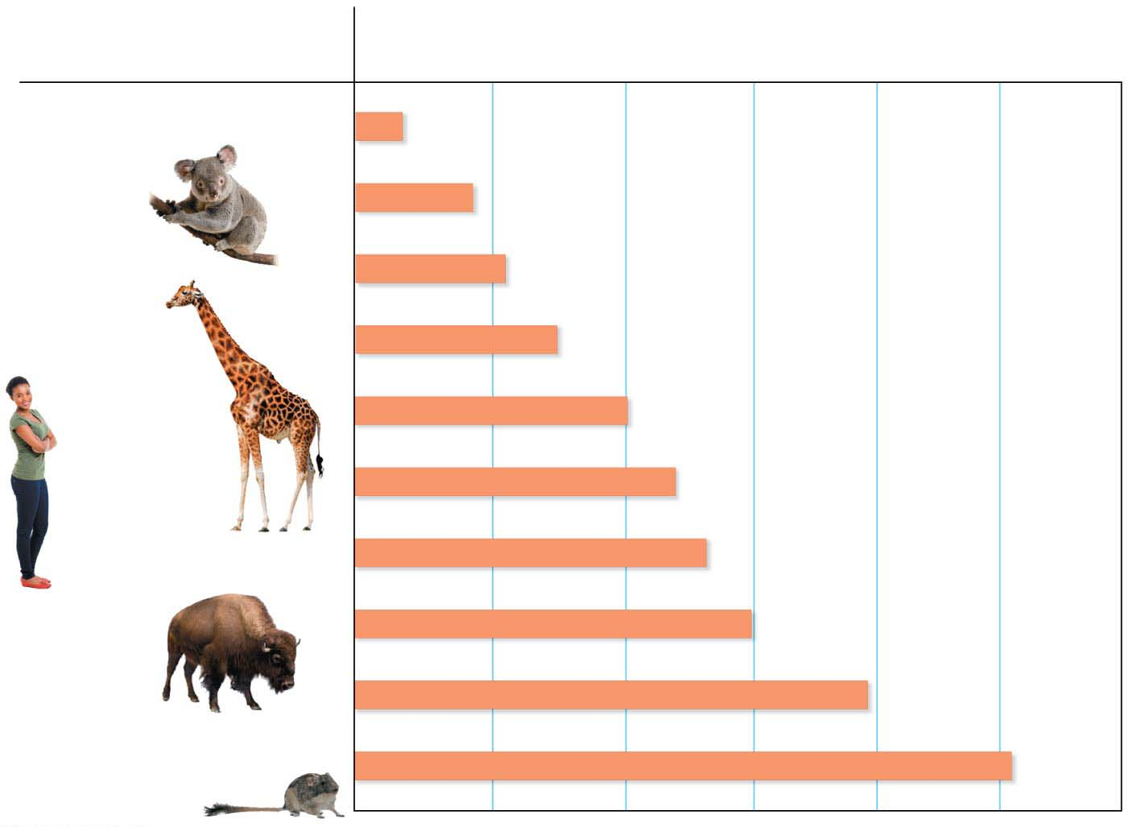
Figure 8.2
Species
Number of chromosomes in body cells
Indian muntjac deer
6
Koala
16
Opossum
22
Giraffe
30
Mouse
40
Human
46
Duck-billed platypus
54
Bison
60
Dog
78
Red viscacha rat
102
Notes:
Figure 8.2 The number of chromosomes in the cells of selected mammals

Slide 5
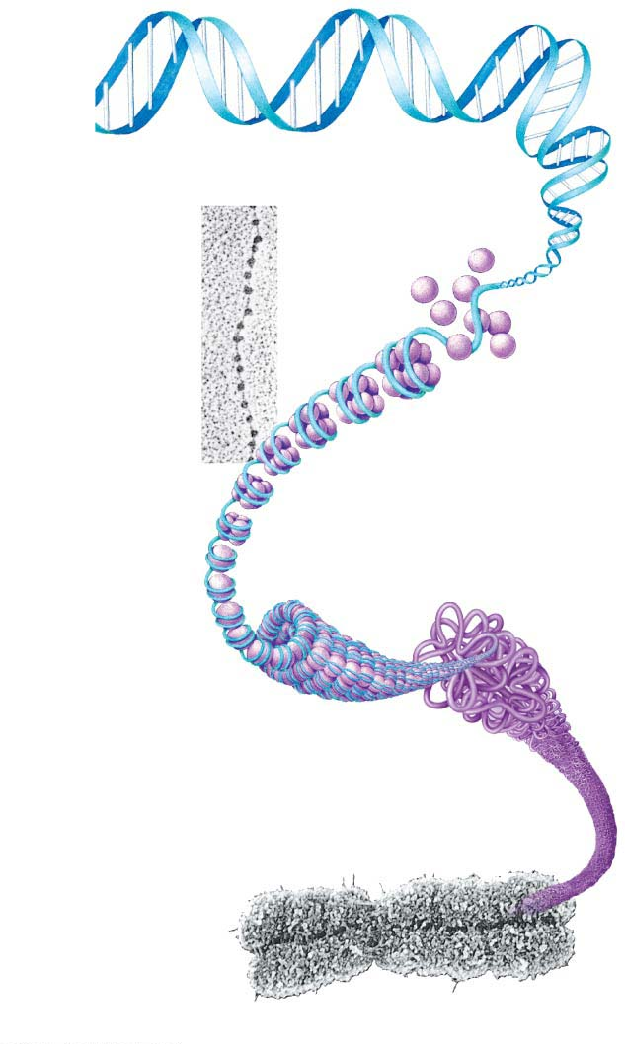
Figure 8.4
DNA double helix
Histones
“Beads
on a
string”
TEM
Nucleosome
Duplicated
chromosomes
(sister
chromatids)
TEM
자매염색분체
Centromere
Notes:
Figure 8.4 DNA packing in a eukaryotic chromosome

Slide 6
Information Flow: Duplicating Chromosomes
Before a cell begins the division process,
the DNA molecule of each chromosome is copied through the process of DNA replication and
new histone protein molecules attach as needed.
The result is that each chromosome consists of two copies called sister chromatids자매염색분체, which contain identical genes.
Two sister chromatids are joined together tightly at a narrow “waist” called the centromere동원체.
When the cell divides, the sister chromatids of a duplicated chromosome separate from each other.
Once separated from its sister, each chromatid염색분체
is considered a full-fledged chromosome and
is identical to the original chromosome.
Notes:
6
Student Misconceptions and Concerns
1. Students often seem confused by the difference between a DNA molecule and a chromosome. This is especially problematic in this chapter when discussing DNA replication.
2. Students are often confused by photographs of chromosomes. A chromosome is often described as a single strand, yet photographs typically show duplicated chromosomes appearing like the letter “X.” It remains unclear to many students why (a) chromosome structure is typically different between interphase G₁ and stages of division and (b) why chromosomes are not photographed during interphase (the stage in which chromosomes are typically first discussed) before the chromosomes replicate.
3. Students do not typically know that all cancers are genetically based. Consider making this clear early in your discussions. Challenge your students to explain how certain viruses can lead to cancer (such as HPV, human papillomavirus, associated with genital warts and cervical cancer).
Teaching Tips
1. Mitochondrial DNA is widely used to analyze evolutionary relationships. Students might be challenged to search the Internet for examples of its use in tracing human evolutionary history.
2. Consider this additional analogy between histones and DNA. DNA is like a very long piece of thread wrapped around a series of spools (histones). The DNA wraps one spool, then extends to another spool, repeating this many hundreds of times—all with one continuous strand of thread.
3. The concepts of DNA replication and sister chromatids are often obstacles for many students. If you can find twist ties or other bendable wire, you can demonstrate or have students model the difference between (a) a chromosome before DNA replication and (b) sister chromatids after DNA replication. One piece of wire will represent a chromosome before replication. Two twist ties twisted about each other can represent sister chromatids (even though this is not the actual physical relationship between sister chromatids). In the model, we have doubled the DNA, but the molecules remain attached. (You might also want to point out that when sister chromatids are separated, they are considered separate chromosomes.)
4. In G₁, the chromosomes have not replicated. But by G₂, chromosomes consist of sister chromatids. If you have created a demonstration of sister chromatids, relate DNA replication and sister chromatids to the cell cycle.
5. The cell cycle control system is somewhat like the control device of an automatic washing machine. Each has a control system that triggers and coordinates key events in the cycle. However, the components of the control system of a cell cycle are not located in one place, like a washing machine.
6. Students might keep better track of the sequence of events in a cell cycle by simply memorizing the letters IPMAT. The first letters of interphase, prophase, metaphase, anaphase, and telophase are represented in this made-up word.
7. Many students think of mitosis and cytokinesis as one process. In some situations, mitosis occurs without subsequent cytokinesis. Challenge your students to predict the outcome of mitosis without cytokinesis (multinuclear cells called a syncytium). One place this occurs is in human development during the formation of the placenta.
8. The authors make an analogy between a drawstring and the mechanism of cytokinesis in animal cells. Students seem to appreciate this analogy. Have your students think of a man who tightens the drawstring of his sweatpants so tight that he pinches himself in two, or perhaps nearly so! The analogy is especially good because the drawstring is just beneath the surface of the sweatpants, and the microfilaments are just beneath the surface of the cell’s plasma membrane.
9. Chemotherapy has some disastrous side effects. The drugs used to fight cancer attack rapidly dividing cells. Unfortunately for men, the cells that make sperm are also rapidly dividing. In some circumstances, chemotherapy can leave a man infertile (unable to produce viable sperm) but still able to produce an erection.
10. Many other approaches (such as cancer vaccines) are under consideration to fight cancers. You may wish to explore these as sidelights to your lecture. Good resources include cell biology and development textbooks.
Active Lecture Tips
1. See the Activity Student Demonstration of Mitosis and Meiosis Using Chromosome Cut-Outs as Models on the Instructor Exchange. Visit the Instructor Exchange in the MasteringBiology instructor resource area for a description of this activity.
2. See the Activity Losing Control of a Car Relates to Unregulated Cell Division on the Instructor Exchange. Visit the Instructor Exchange in the MasteringBiology instructor resource area for a description of this activity.

Slide 7
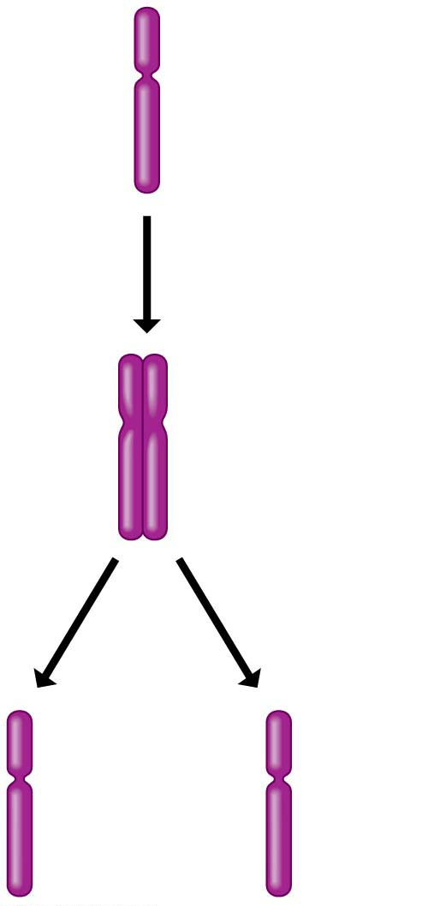
Figure 8.5
Chromosome
duplication
Sister
chromatids
Chromosome
distribution to
daughter cells
Notes:
Figure 8.5 Duplication and distribution of a single chromosome

Slide 8
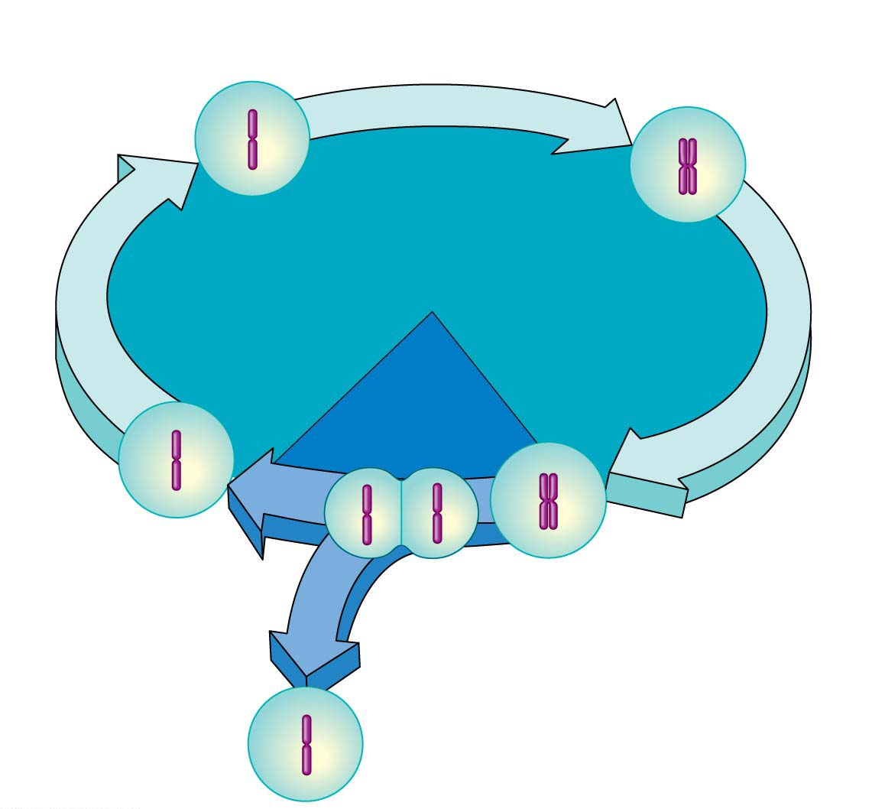
Figure 8.6
S phase
(DNA synthesis; chromosome duplication)
The Cell Cycle
세포주기
Interphase: metabolism and
growth (90% of time)
G₁
G₂
Mitotic
(M) phase:
cell division
(10% of time)
G, gap
Cytokinesis
(division of
cytoplasm)
Mitosis
(division of
nucleus)
ordered sequence of events that extend from the time a cell is first formed from a dividing parent cell to its own division into two cells
Notes:
Figure 8.6 The eukaryotic cell cycle

Slide 9
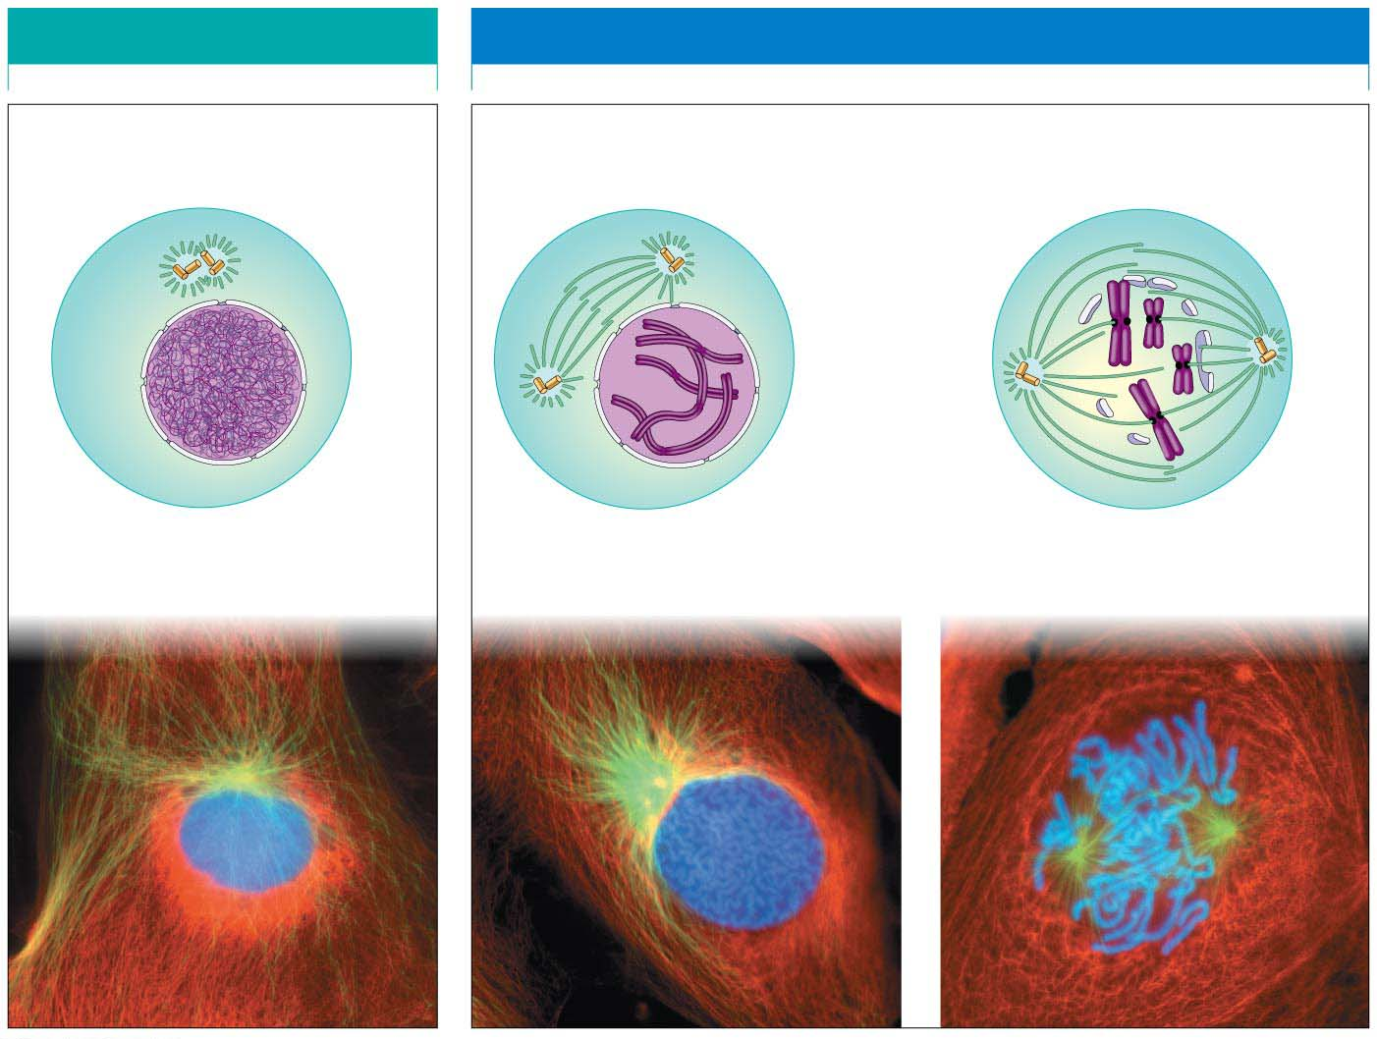
Figure 8.7-1
INTERPHASE
PROPHASE
Centro-
somes
Uncondensed
chromosome
Mitotic spindle
forming
Fragments
of nuclear
envelope
Condensed
chromosome
Centromere
Nuclear
envelope
Plasma
membrane
Chromosome
(two sister chromatids)
Spindle tracks
Notes:
Figure 8.7-1 Cell reproduction: a dance of the chromosomes (part 1: interphase and prophase)

Slide 10
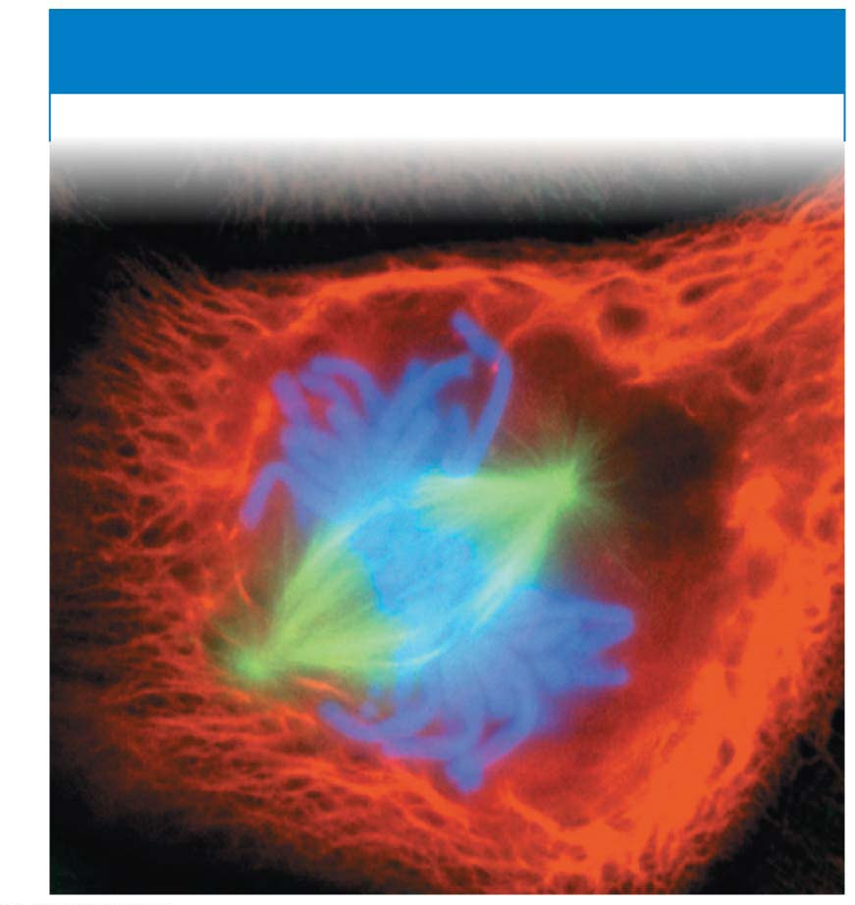
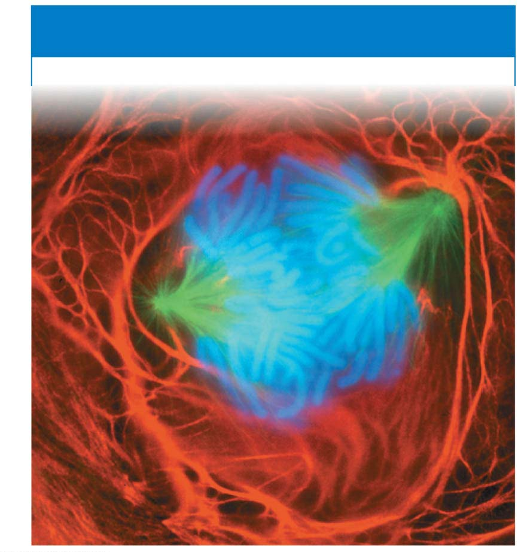
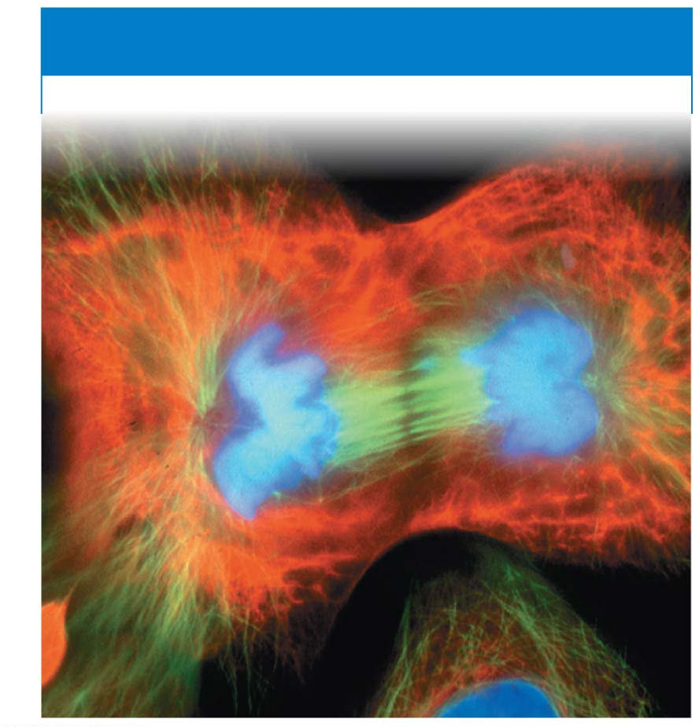
Figure 8.7-2a
Condensed chromosomes align in the middle
Separated chromosomes pulled away by spindle fiber
Nuclear envelope forming
METAPHASE
ANAPHASE
TELOPHASE
Cytokinesis in progress
Notes:
Figure 8.7-2a Cell reproduction: a dance of the chromosomes (part 2a: metaphase)

Slide 11
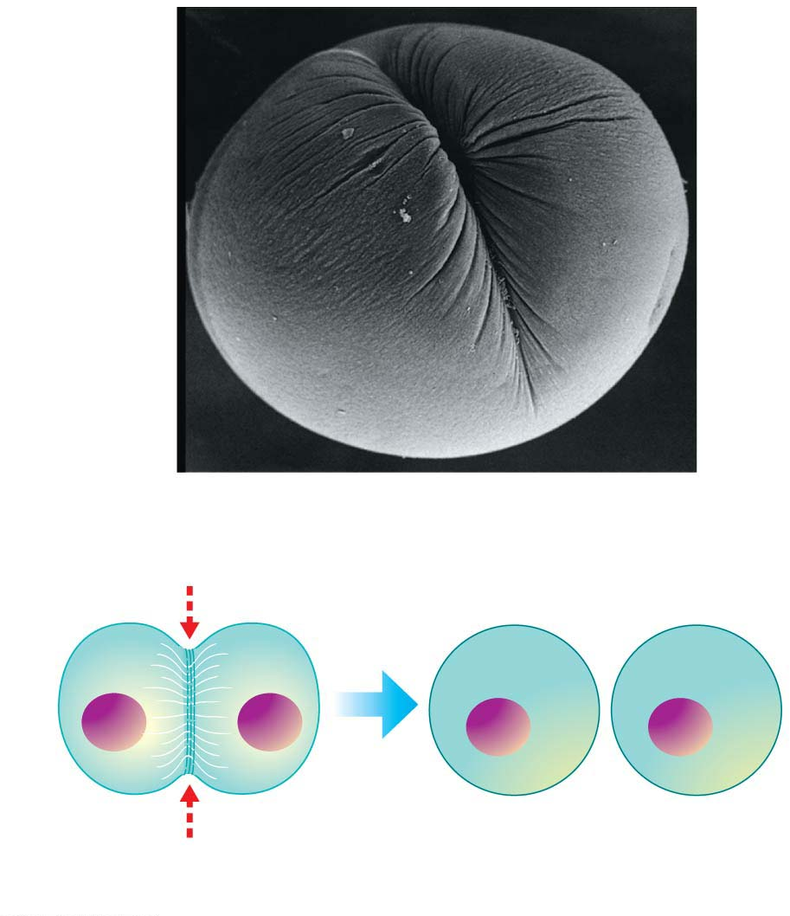
Figure 8.8-1
SEM
Cleavage
furrow
Cleavage furrow
Contracting ring of
microfilaments
Daughter cells
(a) Animal cell cytokinesis
Notes:
Figure 8.8-1 Cytokinesis in animal and plant cells (part 1: animal)

Slide 12
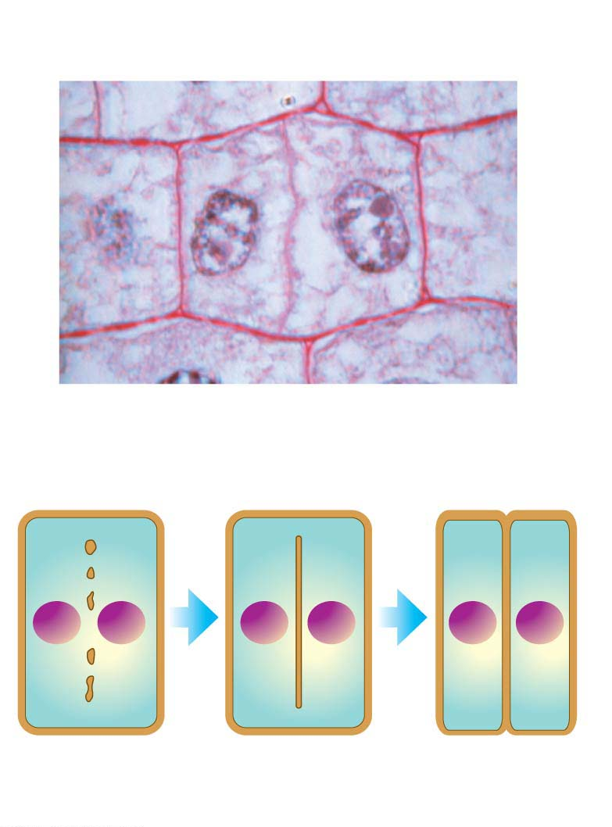
Figure 8.8-2
Wall of
parent cell
Cell plate
forming
Daughter
nucleus
LM
Cell
wall
Vesicles containing
cell wall material
New
cell wall
Cell plate
Daughter cells
(b) Plant cell cytokinesis
Notes:
Figure 8.8-2 Cytokinesis in animal and plant cells (part 2: plant cell)

Slide 13
What Is Cancer?
Cancer is a disease of the cell cycle.
Cancer cells
do not respond normally to the cell cycle control system,
divide excessively, and
may invade other tissues of the body.
The abnormal behavior of cancer cells begins when
a single cell undergoes genetic changes (mutations) in one or more genes that encode for proteins in the cell cycle control system and
these changes cause the cell to grow abnormally.
Cancer cells can form tumors종양, abnormally growing masses of body cells.
If the abnormal cells remain at the original site, the lump is called a benign tumor양성종양.
Malignant tumors악성종양 can spread into neighboring tissues and other parts of the body, forming new tumors, and can interrupt organ function.
An individual with a malignant tumor is said to have cancer.
The spread of cancer cells beyond their original site is called metastasis전이.
Notes:
13
Student Misconceptions and Concerns
1. Students often seem confused by the difference between a DNA molecule and a chromosome. This is especially problematic in this chapter when discussing DNA replication.
2. Students are often confused by photographs of chromosomes. A chromosome is often described as a single strand, yet photographs typically show duplicated chromosomes appearing like the letter “X.” It remains unclear to many students why (a) chromosome structure is typically different between interphase G₁ and stages of division and (b) why chromosomes are not photographed during interphase (the stage in which chromosomes are typically first discussed) before the chromosomes replicate.
3. Students do not typically know that all cancers are genetically based. Consider making this clear early in your discussions. Challenge your students to explain how certain viruses can lead to cancer (such as HPV, human papillomavirus, associated with genital warts and cervical cancer).
Teaching Tips
1. Mitochondrial DNA is widely used to analyze evolutionary relationships. Students might be challenged to search the Internet for examples of its use in tracing human evolutionary history.
2. Consider this additional analogy between histones and DNA. DNA is like a very long piece of thread wrapped around a series of spools (histones). The DNA wraps one spool, then extends to another spool, repeating this many hundreds of times—all with one continuous strand of thread.
3. The concepts of DNA replication and sister chromatids are often obstacles for many students. If you can find twist ties or other bendable wire, you can demonstrate or have students model the difference between (a) a chromosome before DNA replication and (b) sister chromatids after DNA replication. One piece of wire will represent a chromosome before replication. Two twist ties twisted about each other can represent sister chromatids (even though this is not the actual physical relationship between sister chromatids). In the model, we have doubled the DNA, but the molecules remain attached. (You might also want to point out that when sister chromatids are separated, they are considered separate chromosomes.)
4. In G₁, the chromosomes have not replicated. But by G₂, chromosomes consist of sister chromatids. If you have created a demonstration of sister chromatids, relate DNA replication and sister chromatids to the cell cycle.
5. The cell cycle control system is somewhat like the control device of an automatic washing machine. Each has a control system that triggers and coordinates key events in the cycle. However, the components of the control system of a cell cycle are not located in one place, like a washing machine.
6. Students might keep better track of the sequence of events in a cell cycle by simply memorizing the letters IPMAT. The first letters of interphase, prophase, metaphase, anaphase, and telophase are represented in this made-up word.
7. Many students think of mitosis and cytokinesis as one process. In some situations, mitosis occurs without subsequent cytokinesis. Challenge your students to predict the outcome of mitosis without cytokinesis (multinuclear cells called a syncytium). One place this occurs is in human development during the formation of the placenta.
8. The authors make an analogy between a drawstring and the mechanism of cytokinesis in animal cells. Students seem to appreciate this analogy. Have your students think of a man who tightens the drawstring of his sweatpants so tight that he pinches himself in two, or perhaps nearly so! The analogy is especially good because the drawstring is just beneath the surface of the sweatpants, and the microfilaments are just beneath the surface of the cell’s plasma membrane.
9. Chemotherapy has some disastrous side effects. The drugs used to fight cancer attack rapidly dividing cells. Unfortunately for men, the cells that make sperm are also rapidly dividing. In some circumstances, chemotherapy can leave a man infertile (unable to produce viable sperm) but still able to produce an erection.
10. Many other approaches (such as cancer vaccines) are under consideration to fight cancers. You may wish to explore these as sidelights to your lecture. Good resources include cell biology and development textbooks.
Active Lecture Tips
1. See the Activity Student Demonstration of Mitosis and Meiosis Using Chromosome Cut-Outs as Models on the Instructor Exchange. Visit the Instructor Exchange in the MasteringBiology instructor resource area for a description of this activity.
2. See the Activity Losing Control of a Car Relates to Unregulated Cell Division on the Instructor Exchange. Visit the Instructor Exchange in the MasteringBiology instructor resource area for a description of this activity.

Slide 14
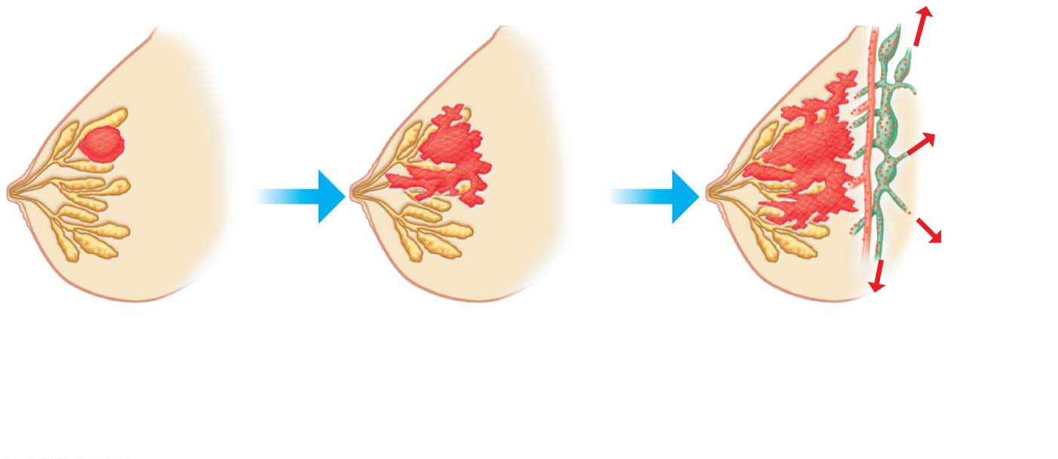
Figure 8.9
Lymph
vessels
Tumor
Blood
vessel
Glandular
tissue
A tumor grows from
a single cancer cell.
Cancer cells invade
neighboring tissue.
Metastasis: Cancer cells
spread through lymph
and blood vessels to
other parts of the body.
Notes:
Figure 8.9 Growth and metastasis of a malignant tumor of the breast

Slide 15
Cancer Treatment
There are three main types of cancer treatment.
Surgery to remove a tumor is usually the first step.
In radiation therapy방사선치료, parts of the body that have cancerous tumors are exposed to concentrated beams of high-energy radiation, which often harm cancer cells more than normal cells. Radiation therapy is often effective against malignant tumors that have not yet spread.
Chemotherapy화학요법, the use of drugs to disrupt cell division, is used to treat widespread or metastatic tumors.
Notes:
15
Student Misconceptions and Concerns
1. Students often seem confused by the difference between a DNA molecule and a chromosome. This is especially problematic in this chapter when discussing DNA replication.
2. Students are often confused by photographs of chromosomes. A chromosome is often described as a single strand, yet photographs typically show duplicated chromosomes appearing like the letter “X.” It remains unclear to many students why (a) chromosome structure is typically different between interphase G₁ and stages of division and (b) why chromosomes are not photographed during interphase (the stage in which chromosomes are typically first discussed) before the chromosomes replicate.
3. Students do not typically know that all cancers are genetically based. Consider making this clear early in your discussions. Challenge your students to explain how certain viruses can lead to cancer (such as HPV, human papillomavirus, associated with genital warts and cervical cancer).
Teaching Tips
1. Mitochondrial DNA is widely used to analyze evolutionary relationships. Students might be challenged to search the Internet for examples of its use in tracing human evolutionary history.
2. Consider this additional analogy between histones and DNA. DNA is like a very long piece of thread wrapped around a series of spools (histones). The DNA wraps one spool, then extends to another spool, repeating this many hundreds of times—all with one continuous strand of thread.
3. The concepts of DNA replication and sister chromatids are often obstacles for many students. If you can find twist ties or other bendable wire, you can demonstrate or have students model the difference between (a) a chromosome before DNA replication and (b) sister chromatids after DNA replication. One piece of wire will represent a chromosome before replication. Two twist ties twisted about each other can represent sister chromatids (even though this is not the actual physical relationship between sister chromatids). In the model, we have doubled the DNA, but the molecules remain attached. (You might also want to point out that when sister chromatids are separated, they are considered separate chromosomes.)
4. In G₁, the chromosomes have not replicated. But by G₂, chromosomes consist of sister chromatids. If you have created a demonstration of sister chromatids, relate DNA replication and sister chromatids to the cell cycle.
5. The cell cycle control system is somewhat like the control device of an automatic washing machine. Each has a control system that triggers and coordinates key events in the cycle. However, the components of the control system of a cell cycle are not located in one place, like a washing machine.
6. Students might keep better track of the sequence of events in a cell cycle by simply memorizing the letters IPMAT. The first letters of interphase, prophase, metaphase, anaphase, and telophase are represented in this made-up word.
7. Many students think of mitosis and cytokinesis as one process. In some situations, mitosis occurs without subsequent cytokinesis. Challenge your students to predict the outcome of mitosis without cytokinesis (multinuclear cells called a syncytium). One place this occurs is in human development during the formation of the placenta.
8. The authors make an analogy between a drawstring and the mechanism of cytokinesis in animal cells. Students seem to appreciate this analogy. Have your students think of a man who tightens the drawstring of his sweatpants so tight that he pinches himself in two, or perhaps nearly so! The analogy is especially good because the drawstring is just beneath the surface of the sweatpants, and the microfilaments are just beneath the surface of the cell’s plasma membrane.
9. Chemotherapy has some disastrous side effects. The drugs used to fight cancer attack rapidly dividing cells. Unfortunately for men, the cells that make sperm are also rapidly dividing. In some circumstances, chemotherapy can leave a man infertile (unable to produce viable sperm) but still able to produce an erection.
10. Many other approaches (such as cancer vaccines) are under consideration to fight cancers. You may wish to explore these as sidelights to your lecture. Good resources include cell biology and development textbooks.
Active Lecture Tips
1. See the Activity Student Demonstration of Mitosis and Meiosis Using Chromosome Cut-Outs as Models on the Instructor Exchange. Visit the Instructor Exchange in the MasteringBiology instructor resource area for a description of this activity.
2. See the Activity Losing Control of a Car Relates to Unregulated Cell Division on the Instructor Exchange. Visit the Instructor Exchange in the MasteringBiology instructor resource area for a description of this activity.

Slide 16
Meiosis감수분열, the Basis of Sexual Reproduction
Sexual reproduction
produces offspring that contain a unique combination of genes from the parents and
depends on the cellular processes of meiosis and fertilization.
Notes:
16
Student Misconceptions and Concerns
1. How meiosis results in four haploid cells yet mitosis yields two diploid cells is often memorized but not understood. It can be explained like this. In mitosis and meiosis, the processes begin with replicated pairs of chromosomes. The two pairs include four items. Sort this group into two subgroups, and you are back to two pairs. Divide again, and you have separated four items into four groups of one. All of the details of these two processes, although eventually addressed, can get in the way of seeing the overall process.
2. Most people have difficulty comprehending large numbers. See Teaching Tips 7–9 below to help relate these large numbers to aspects of students’ lives.
Teaching Tips
1. Consider helping students through mitosis and meiosis by developing an analogy to pairs of shoes. In this case, any given species that is diploid has a certain number of pairs of shoes, or homologous chromosomes.
2. In the shoe analogy, females have 23 pairs of matching shoes, and males have 22 matching pairs and one odd pair—maybe a sandal and a sneaker!
3. You may wish to ask the class why meiosis is necessary. Why not have a male diploid cell fertilize a diploid female cell? In short, the answer is that, if this were true, at every fertilization, we would have genetic doubling.
4. If you wish to continue the shoe analogy, crossing over is somewhat like exchanging the shoelaces in a pair of shoes. A point to make is that the shoes (chromosomes) before crossing over are what you inherited—from either the sperm or the egg; but as a result of crossing over, you no longer pass along exactly what you inherited. Instead, you pass along a combination of homologous chromosomes (or shoes with switched shoelaces). In this shoe analogy, after exchanging shoelaces, we have recombinant shoes!
5. You might consider emphasizing a crucial difference between the processes of mitosis and meiosis. In mitosis, sister chromatids separate at metaphase. In meiosis I metaphase, sister chromatids stay together, and homologous chromosomes separate. After discussing mitosis and meiosis in class, consider asking your students to sketch the alignment of the chromosomes at mitosis metaphase and meiosis I metaphase.
6. The number 2²³ is 8,388,608. This number squared is more than 70 trillion. The authors rounded down to 8 million for 2²³ and squared this to estimate 64 trillion possible combinations. But more precisely, the number of possible zygotes produced by a single pair of reproducing humans, based solely on independent assortment and random fertilization, is over 70 trillion!
7. There are currently about 320 million humans living in the United States. If every person in the United States received about $217,000, it would equal $70 trillion. Here is another way to think of it. If you lived to be 100 years old and spent $22,181.66 every second of your life, (or a million dollars every 45 seconds) you would spend about $70 trillion dollars.
8. The impressive nature of such large numbers is lost on most of us who cannot comprehend such quantities. There are about 64 trillion seconds in 2 million years (actually, 2,028,000 years).
9. Depending on the size of your class, it is likely that at least one of your students has a friend or relative with Down syndrome. A student in your class may even enjoy the chance to talk about their friend or relative.
Active Lecture Tips
1. Sometimes the most basic questions can challenge students and get them focused on the subject at hand. Consider asking your students to work with other students near them to consider why we expect that dogs produce dogs, cats produce only more cats, and chickens only produce chickens. Why does “like produce like”?
2. See the Activity Student Demonstration of Mitosis and Meiosis Using Chromosome Cut-Outs as Models on the Instructor Exchange. Visit the Instructor Exchange in the MasteringBiology instructor resource area for a description of this activity.
3. See the Activity Applying the Concept of Nondisjunction to Trisomy on the Instructor Exchange. Visit the Instructor Exchange in the MasteringBiology instructor resource area for a description of this activity.

Slide 17
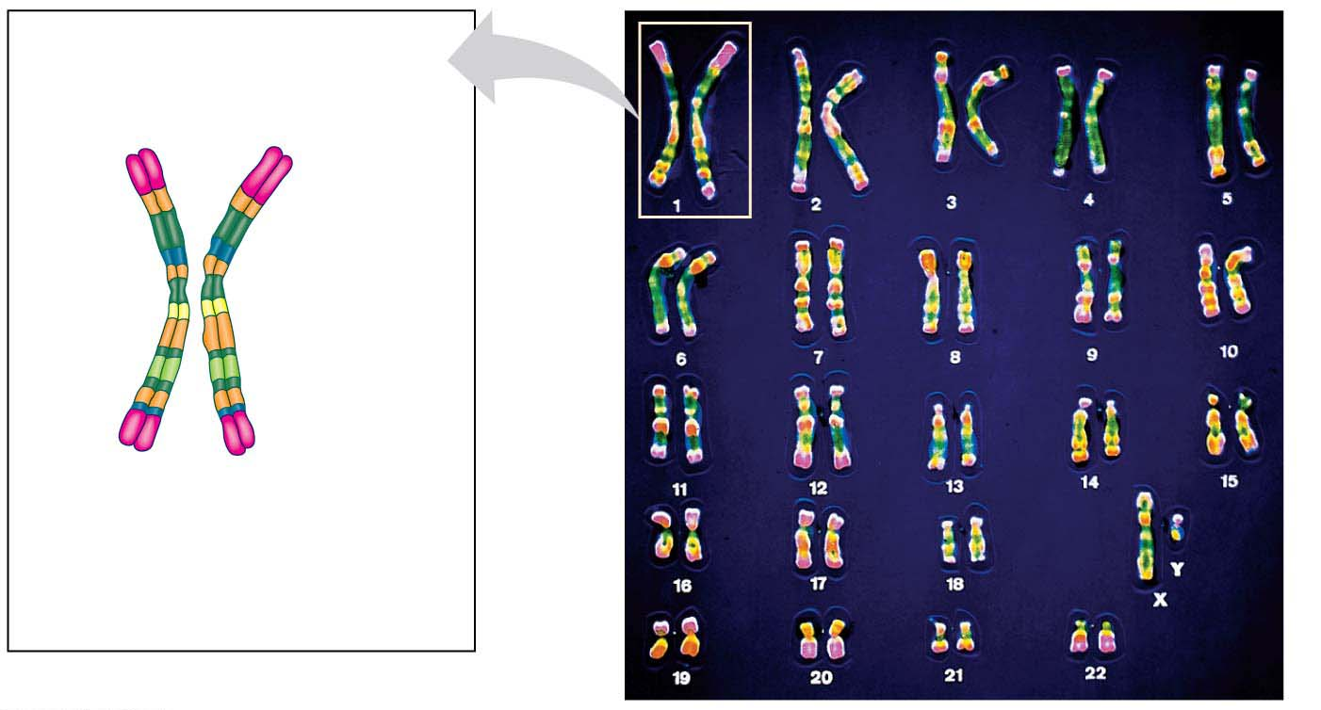
Figure 8.11
Pair of homologous
chromosomes
LM
Centromere
Sister
chromatids
One
duplicated
chromosome
Karyotype핵형
Notes:
Figure 8.11 Pairs of homologous chromosomes in a human male karyotype

Slide 18
Humans have 46 chromosomes:
22 pairs of matching chromosomes, called autosomes상염색체, and
two different sex chromosomes성염색체, X and Y, which determine a person’s sex (male or female).
In mammals,
males have one X chromosome and one Y chromosome and
females have two X chromosomes.
Notes:
18
Student Misconceptions and Concerns
1. How meiosis results in four haploid cells yet mitosis yields two diploid cells is often memorized but not understood. It can be explained like this. In mitosis and meiosis, the processes begin with replicated pairs of chromosomes. The two pairs include four items. Sort this group into two subgroups, and you are back to two pairs. Divide again, and you have separated four items into four groups of one. All of the details of these two processes, although eventually addressed, can get in the way of seeing the overall process.
2. Most people have difficulty comprehending large numbers. See Teaching Tips 7–9 below to help relate these large numbers to aspects of students’ lives.
Teaching Tips
1. Consider helping students through mitosis and meiosis by developing an analogy to pairs of shoes. In this case, any given species that is diploid has a certain number of pairs of shoes, or homologous chromosomes.
2. In the shoe analogy, females have 23 pairs of matching shoes, and males have 22 matching pairs and one odd pair—maybe a sandal and a sneaker!
3. You may wish to ask the class why meiosis is necessary. Why not have a male diploid cell fertilize a diploid female cell? In short, the answer is that, if this were true, at every fertilization, we would have genetic doubling.
4. If you wish to continue the shoe analogy, crossing over is somewhat like exchanging the shoelaces in a pair of shoes. A point to make is that the shoes (chromosomes) before crossing over are what you inherited—from either the sperm or the egg; but as a result of crossing over, you no longer pass along exactly what you inherited. Instead, you pass along a combination of homologous chromosomes (or shoes with switched shoelaces). In this shoe analogy, after exchanging shoelaces, we have recombinant shoes!
5. You might consider emphasizing a crucial difference between the processes of mitosis and meiosis. In mitosis, sister chromatids separate at metaphase. In meiosis I metaphase, sister chromatids stay together, and homologous chromosomes separate. After discussing mitosis and meiosis in class, consider asking your students to sketch the alignment of the chromosomes at mitosis metaphase and meiosis I metaphase.
6. The number 2²³ is 8,388,608. This number squared is more than 70 trillion. The authors rounded down to 8 million for 2²³ and squared this to estimate 64 trillion possible combinations. But more precisely, the number of possible zygotes produced by a single pair of reproducing humans, based solely on independent assortment and random fertilization, is over 70 trillion!
7. There are currently about 320 million humans living in the United States. If every person in the United States received about $217,000, it would equal $70 trillion. Here is another way to think of it. If you lived to be 100 years old and spent $22,181.66 every second of your life, (or a million dollars every 45 seconds) you would spend about $70 trillion dollars.
8. The impressive nature of such large numbers is lost on most of us who cannot comprehend such quantities. There are about 64 trillion seconds in 2 million years (actually, 2,028,000 years).
9. Depending on the size of your class, it is likely that at least one of your students has a friend or relative with Down syndrome. A student in your class may even enjoy the chance to talk about their friend or relative.
Active Lecture Tips
1. Sometimes the most basic questions can challenge students and get them focused on the subject at hand. Consider asking your students to work with other students near them to consider why we expect that dogs produce dogs, cats produce only more cats, and chickens only produce chickens. Why does “like produce like”?
2. See the Activity Student Demonstration of Mitosis and Meiosis Using Chromosome Cut-Outs as Models on the Instructor Exchange. Visit the Instructor Exchange in the MasteringBiology instructor resource area for a description of this activity.
3. See the Activity Applying the Concept of Nondisjunction to Trisomy on the Instructor Exchange. Visit the Instructor Exchange in the MasteringBiology instructor resource area for a description of this activity.

Slide 19
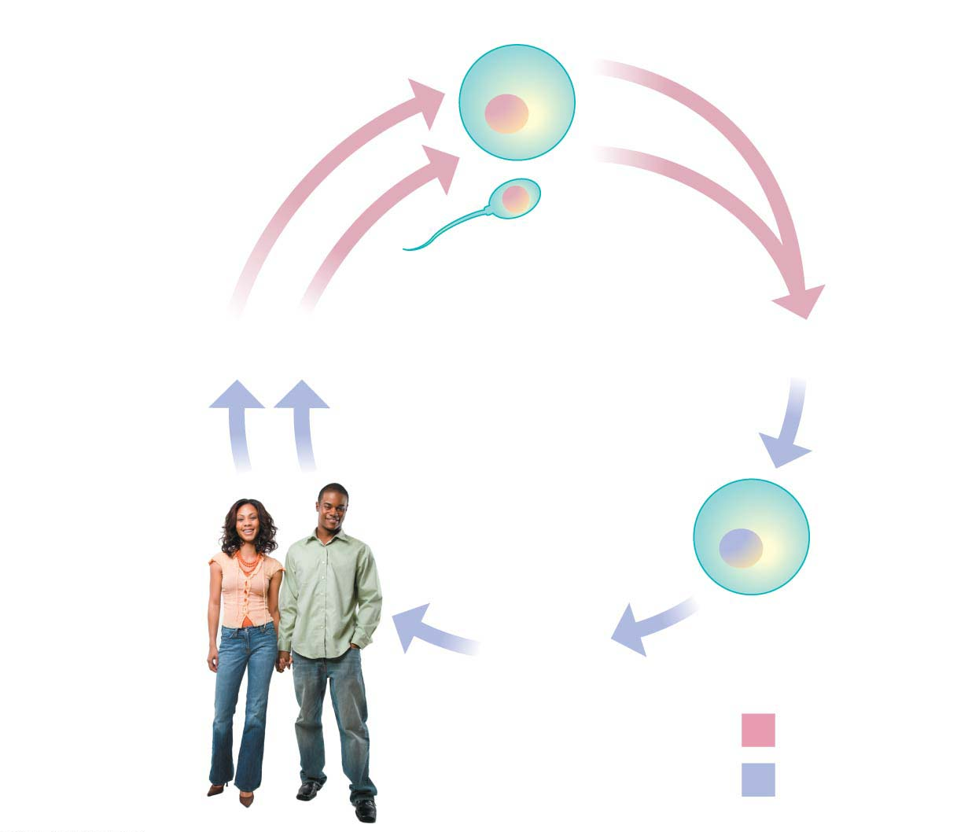
Figure 8.12
Haploid gametes (n = 23)
n
Egg cell
Human life cycle
n
Sperm cell
MEIOSIS
FERTILIZATION
Multicellular
diploid adults
(2n = 46)
Diploid
zygote
(2n = 46)
2n
MITOSIS
and development
Key
Haploid (n)
Diploid (2n)
Notes:
Figure 8.12 The human life cycle

Slide 20
Humans are said to be diploid이배체 organisms because all body cells contain pairs of homologous chromosomes.
A haploid단배체 cell has only one member of each pair of homologous chromosomes.
In the human life cycle, a haploid sperm cell from the father fuses with a haploid egg cell from the mother in a process called fertilization.
The resulting fertilized egg, called a zygote접합자, is diploid, with two sets of chromosomes, one set from each parent.
All sexual life cycles involve an alternation of diploid and haploid stages.
Producing haploid gametes by meiosis keeps the chromosome number from doubling in every generation.
Notes:
20
Student Misconceptions and Concerns
1. How meiosis results in four haploid cells yet mitosis yields two diploid cells is often memorized but not understood. It can be explained like this. In mitosis and meiosis, the processes begin with replicated pairs of chromosomes. The two pairs include four items. Sort this group into two subgroups, and you are back to two pairs. Divide again, and you have separated four items into four groups of one. All of the details of these two processes, although eventually addressed, can get in the way of seeing the overall process.
2. Most people have difficulty comprehending large numbers. See Teaching Tips 7–9 below to help relate these large numbers to aspects of students’ lives.
Teaching Tips
1. Consider helping students through mitosis and meiosis by developing an analogy to pairs of shoes. In this case, any given species that is diploid has a certain number of pairs of shoes, or homologous chromosomes.
2. In the shoe analogy, females have 23 pairs of matching shoes, and males have 22 matching pairs and one odd pair—maybe a sandal and a sneaker!
3. You may wish to ask the class why meiosis is necessary. Why not have a male diploid cell fertilize a diploid female cell? In short, the answer is that, if this were true, at every fertilization, we would have genetic doubling.
4. If you wish to continue the shoe analogy, crossing over is somewhat like exchanging the shoelaces in a pair of shoes. A point to make is that the shoes (chromosomes) before crossing over are what you inherited—from either the sperm or the egg; but as a result of crossing over, you no longer pass along exactly what you inherited. Instead, you pass along a combination of homologous chromosomes (or shoes with switched shoelaces). In this shoe analogy, after exchanging shoelaces, we have recombinant shoes!
5. You might consider emphasizing a crucial difference between the processes of mitosis and meiosis. In mitosis, sister chromatids separate at metaphase. In meiosis I metaphase, sister chromatids stay together, and homologous chromosomes separate. After discussing mitosis and meiosis in class, consider asking your students to sketch the alignment of the chromosomes at mitosis metaphase and meiosis I metaphase.
6. The number 2²³ is 8,388,608. This number squared is more than 70 trillion. The authors rounded down to 8 million for 2²³ and squared this to estimate 64 trillion possible combinations. But more precisely, the number of possible zygotes produced by a single pair of reproducing humans, based solely on independent assortment and random fertilization, is over 70 trillion!
7. There are currently about 320 million humans living in the United States. If every person in the United States received about $217,000, it would equal $70 trillion. Here is another way to think of it. If you lived to be 100 years old and spent $22,181.66 every second of your life, (or a million dollars every 45 seconds) you would spend about $70 trillion dollars.
8. The impressive nature of such large numbers is lost on most of us who cannot comprehend such quantities. There are about 64 trillion seconds in 2 million years (actually, 2,028,000 years).
9. Depending on the size of your class, it is likely that at least one of your students has a friend or relative with Down syndrome. A student in your class may even enjoy the chance to talk about their friend or relative.
Active Lecture Tips
1. Sometimes the most basic questions can challenge students and get them focused on the subject at hand. Consider asking your students to work with other students near them to consider why we expect that dogs produce dogs, cats produce only more cats, and chickens only produce chickens. Why does “like produce like”?
2. See the Activity Student Demonstration of Mitosis and Meiosis Using Chromosome Cut-Outs as Models on the Instructor Exchange. Visit the Instructor Exchange in the MasteringBiology instructor resource area for a description of this activity.
3. See the Activity Applying the Concept of Nondisjunction to Trisomy on the Instructor Exchange. Visit the Instructor Exchange in the MasteringBiology instructor resource area for a description of this activity.

Slide 21
The Process of Meiosis
Meiosis, the process of cell division that produces haploid gametes in diploid organisms, resembles mitosis, but with two differences.
The first difference is that the number of chromosomes during meiosis is cut in half.
In meiosis, a cell that has duplicated its chromosomes undergoes two consecutive divisions, called meiosis I and meiosis II.
Because one duplication of the chromosomes is followed by two divisions, each of the four daughter cells resulting from meiosis has a haploid set of chromosomes.
The second difference of meiosis compared with mitosis is an exchange of genetic material—pieces of chromosomes—between homologous chromosomes.
This exchange, called crossing over, occurs during the first prophase of meiosis.
Notes:
21
Student Misconceptions and Concerns
1. How meiosis results in four haploid cells yet mitosis yields two diploid cells is often memorized but not understood. It can be explained like this. In mitosis and meiosis, the processes begin with replicated pairs of chromosomes. The two pairs include four items. Sort this group into two subgroups, and you are back to two pairs. Divide again, and you have separated four items into four groups of one. All of the details of these two processes, although eventually addressed, can get in the way of seeing the overall process.
2. Most people have difficulty comprehending large numbers. See Teaching Tips 7–9 below to help relate these large numbers to aspects of students’ lives.
Teaching Tips
1. Consider helping students through mitosis and meiosis by developing an analogy to pairs of shoes. In this case, any given species that is diploid has a certain number of pairs of shoes, or homologous chromosomes.
2. In the shoe analogy, females have 23 pairs of matching shoes, and males have 22 matching pairs and one odd pair—maybe a sandal and a sneaker!
3. You may wish to ask the class why meiosis is necessary. Why not have a male diploid cell fertilize a diploid female cell? In short, the answer is that, if this were true, at every fertilization, we would have genetic doubling.
4. If you wish to continue the shoe analogy, crossing over is somewhat like exchanging the shoelaces in a pair of shoes. A point to make is that the shoes (chromosomes) before crossing over are what you inherited—from either the sperm or the egg; but as a result of crossing over, you no longer pass along exactly what you inherited. Instead, you pass along a combination of homologous chromosomes (or shoes with switched shoelaces). In this shoe analogy, after exchanging shoelaces, we have recombinant shoes!
5. You might consider emphasizing a crucial difference between the processes of mitosis and meiosis. In mitosis, sister chromatids separate at metaphase. In meiosis I metaphase, sister chromatids stay together, and homologous chromosomes separate. After discussing mitosis and meiosis in class, consider asking your students to sketch the alignment of the chromosomes at mitosis metaphase and meiosis I metaphase.
6. The number 2²³ is 8,388,608. This number squared is more than 70 trillion. The authors rounded down to 8 million for 2²³ and squared this to estimate 64 trillion possible combinations. But more precisely, the number of possible zygotes produced by a single pair of reproducing humans, based solely on independent assortment and random fertilization, is over 70 trillion!
7. There are currently about 320 million humans living in the United States. If every person in the United States received about $217,000, it would equal $70 trillion. Here is another way to think of it. If you lived to be 100 years old and spent $22,181.66 every second of your life, (or a million dollars every 45 seconds) you would spend about $70 trillion dollars.
8. The impressive nature of such large numbers is lost on most of us who cannot comprehend such quantities. There are about 64 trillion seconds in 2 million years (actually, 2,028,000 years).
9. Depending on the size of your class, it is likely that at least one of your students has a friend or relative with Down syndrome. A student in your class may even enjoy the chance to talk about their friend or relative.
Active Lecture Tips
1. Sometimes the most basic questions can challenge students and get them focused on the subject at hand. Consider asking your students to work with other students near them to consider why we expect that dogs produce dogs, cats produce only more cats, and chickens only produce chickens. Why does “like produce like”?
2. See the Activity Student Demonstration of Mitosis and Meiosis Using Chromosome Cut-Outs as Models on the Instructor Exchange. Visit the Instructor Exchange in the MasteringBiology instructor resource area for a description of this activity.
3. See the Activity Applying the Concept of Nondisjunction to Trisomy on the Instructor Exchange. Visit the Instructor Exchange in the MasteringBiology instructor resource area for a description of this activity.

Slide 22
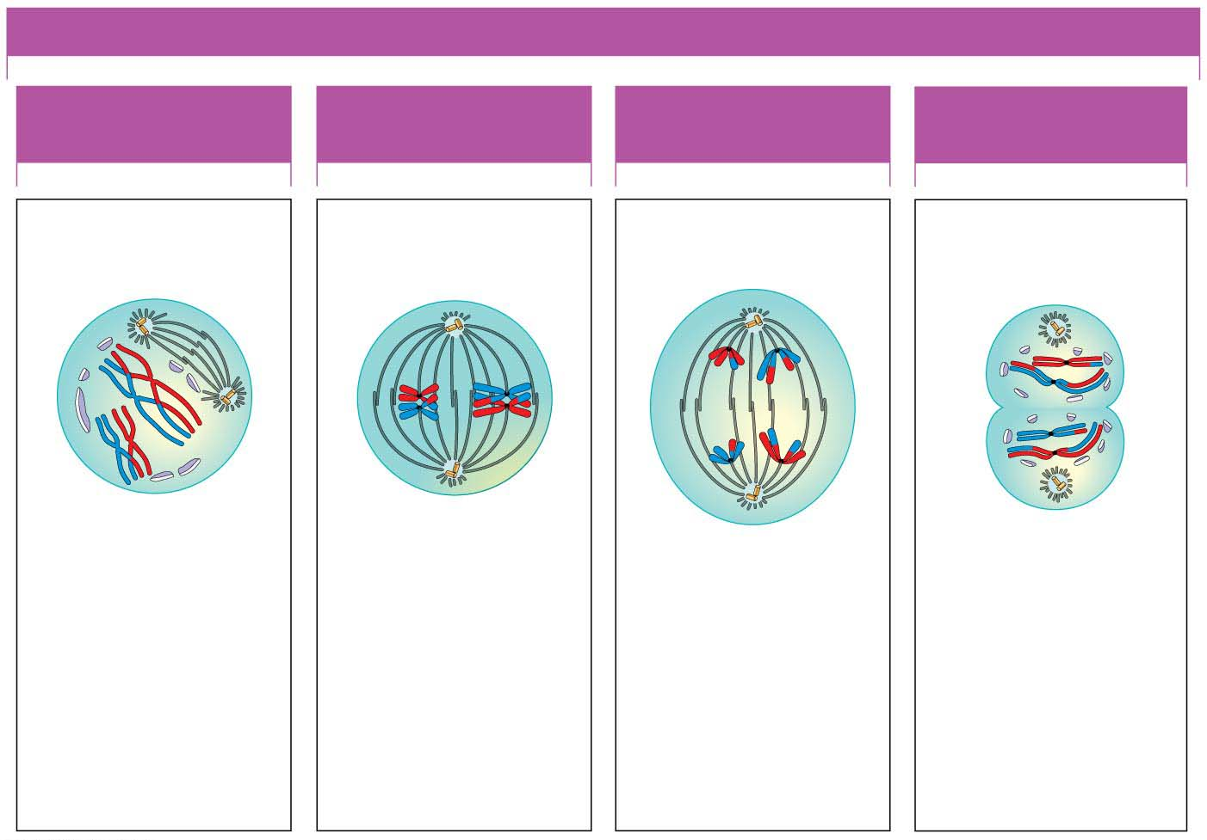
Figure 8.14-2
MEIOSIS I: HOMOLOGOUS CHROMOSOMES SEPARATE
PROPHASE I
METAPHASE I
ANAPHASE I
TELOPHASE I AND
CYTOKINESIS
Sites of
crossing over
Spindle tracks
attached to
chromosome
Sister chromatids
remain attached
Cleavage
furrow
Spindle
Sister
chromatids
Centromere
Pair of
homologous
chromosomes
Homologous
chromosomes
pair up and
exchange
segments.
Pairs of
homologous
chromosomes
line up.
Pairs of
homologous
chromosomes
split up.
Two haploid
cells form;
chromosomes
are still doubled.
Notes:
Figure 8.14-2 The stages of meiosis (part 2: meiosis I)

Slide 23
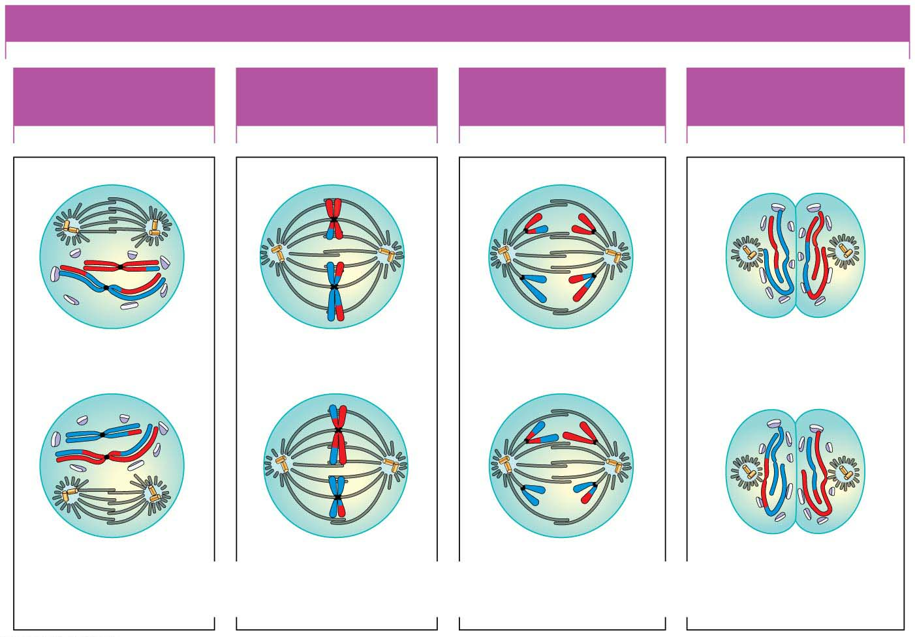
Figure 8.14-3
MEIOSIS II: SISTER CHROMATIDS SEPARATE
PROPHASE II
METAPHASE II
ANAPHASE II
TELOPHASE II AND
CYTOKINESIS
Sister chromatids
separate
Haploid daughter
cells forming
During another round of cell division, the sister chromatids finally separate;
four haploid daughter cells result, containing single chromosomes.
Notes:
Figure 8.14-3 The stages of meiosis (part 3: meiosis II)

Slide 24
The Origins of Genetic Variation유전적 변이
Offspring of sexual reproduction are genetically different from their parents and one another.
How does meiosis produce such genetic variation?
-Independent Assortment독립분리 of Chromosomes
For a human, n = 23, so there are 2²³, or about 8 million, possible chromosome combinations that can appear in gametes.
A single man and a single woman can produce zygotes with 64 trillion combinations of chromosomes!
-Crossing Over교차 of Chromosomes
Exchange of corresponding segments between nonsister chromatids of homologous chromosomes, which occurs during prophase I of meiosis.
With crossing over, gametes arise with chromosomes that are partly from the mother and partly from the father.
Notes:
24
Student Misconceptions and Concerns
1. How meiosis results in four haploid cells yet mitosis yields two diploid cells is often memorized but not understood. It can be explained like this. In mitosis and meiosis, the processes begin with replicated pairs of chromosomes. The two pairs include four items. Sort this group into two subgroups, and you are back to two pairs. Divide again, and you have separated four items into four groups of one. All of the details of these two processes, although eventually addressed, can get in the way of seeing the overall process.
2. Most people have difficulty comprehending large numbers. See Teaching Tips 7–9 below to help relate these large numbers to aspects of students’ lives.
Teaching Tips
1. Consider helping students through mitosis and meiosis by developing an analogy to pairs of shoes. In this case, any given species that is diploid has a certain number of pairs of shoes, or homologous chromosomes.
2. In the shoe analogy, females have 23 pairs of matching shoes, and males have 22 matching pairs and one odd pair—maybe a sandal and a sneaker!
3. You may wish to ask the class why meiosis is necessary. Why not have a male diploid cell fertilize a diploid female cell? In short, the answer is that, if this were true, at every fertilization, we would have genetic doubling.
4. If you wish to continue the shoe analogy, crossing over is somewhat like exchanging the shoelaces in a pair of shoes. A point to make is that the shoes (chromosomes) before crossing over are what you inherited—from either the sperm or the egg; but as a result of crossing over, you no longer pass along exactly what you inherited. Instead, you pass along a combination of homologous chromosomes (or shoes with switched shoelaces). In this shoe analogy, after exchanging shoelaces, we have recombinant shoes!
5. You might consider emphasizing a crucial difference between the processes of mitosis and meiosis. In mitosis, sister chromatids separate at metaphase. In meiosis I metaphase, sister chromatids stay together, and homologous chromosomes separate. After discussing mitosis and meiosis in class, consider asking your students to sketch the alignment of the chromosomes at mitosis metaphase and meiosis I metaphase.
6. The number 2²³ is 8,388,608. This number squared is more than 70 trillion. The authors rounded down to 8 million for 2²³ and squared this to estimate 64 trillion possible combinations. But more precisely, the number of possible zygotes produced by a single pair of reproducing humans, based solely on independent assortment and random fertilization, is over 70 trillion!
7. There are currently about 320 million humans living in the United States. If every person in the United States received about $217,000, it would equal $70 trillion. Here is another way to think of it. If you lived to be 100 years old and spent $22,181.66 every second of your life, (or a million dollars every 45 seconds) you would spend about $70 trillion dollars.
8. The impressive nature of such large numbers is lost on most of us who cannot comprehend such quantities. There are about 64 trillion seconds in 2 million years (actually, 2,028,000 years).
9. Depending on the size of your class, it is likely that at least one of your students has a friend or relative with Down syndrome. A student in your class may even enjoy the chance to talk about their friend or relative.
Active Lecture Tips
1. Sometimes the most basic questions can challenge students and get them focused on the subject at hand. Consider asking your students to work with other students near them to consider why we expect that dogs produce dogs, cats produce only more cats, and chickens only produce chickens. Why does “like produce like”?
2. See the Activity Student Demonstration of Mitosis and Meiosis Using Chromosome Cut-Outs as Models on the Instructor Exchange. Visit the Instructor Exchange in the MasteringBiology instructor resource area for a description of this activity.
3. See the Activity Applying the Concept of Nondisjunction to Trisomy on the Instructor Exchange. Visit the Instructor Exchange in the MasteringBiology instructor resource area for a description of this activity.

Slide 25
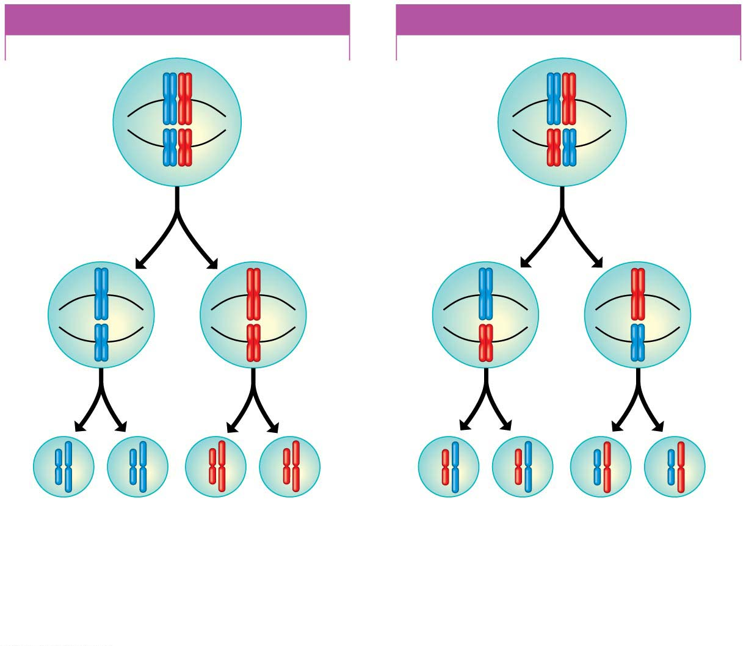
Figure 8.16
POSSIBILITY 1
POSSIBILITY 2
Two equally probable
arrangements of
chromosomes
at metaphase of
meiosis I
Metaphase
of
meiosis II
Gametes
Combination a
Combination b
Combination c
Combination d
Because possibilities 1 and 2 are equally likely, the four possible types
of gametes will be made in approximately equal numbers.
Notes:
Figure 8.16 Results of alternative arrangements of chromosomes at metaphase of meiosis I

Slide 26
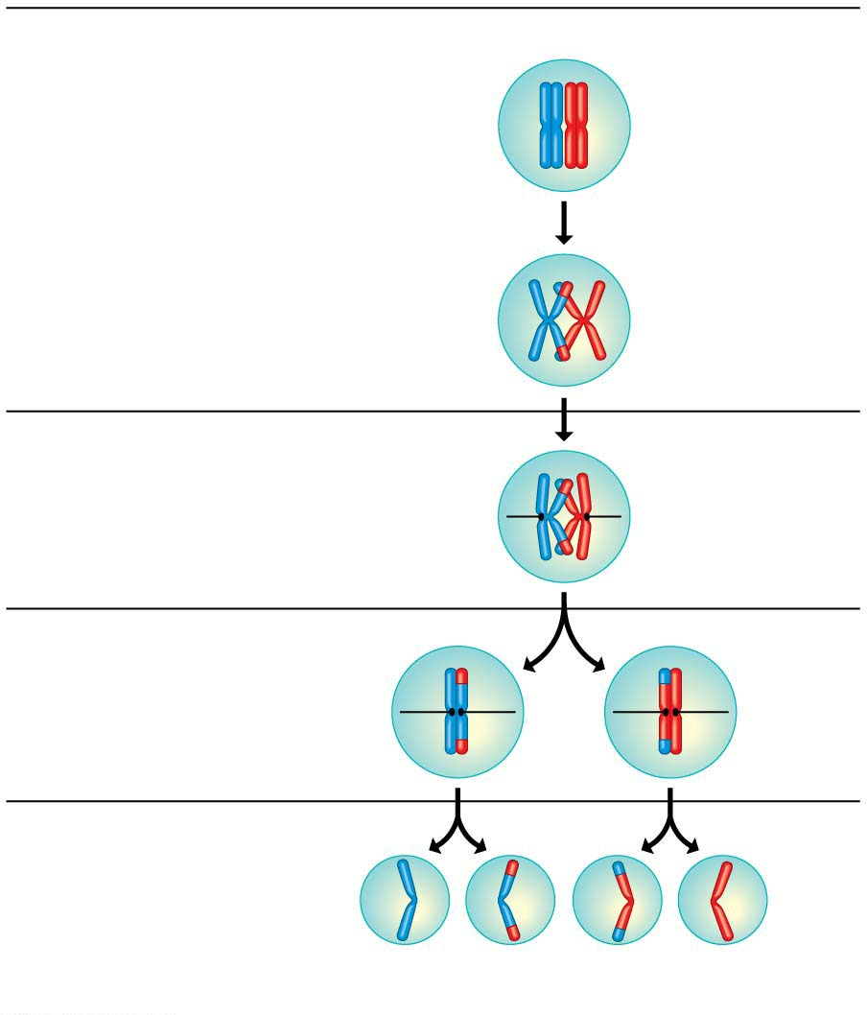
Figure 8.18
Prophase I of meiosis
Duplicated pair
of homologous
chromosomes
Homologous
(nonsister) chromatids
exchange corresponding
segments.
Site of
crossing over
Metaphase I
Sister chromatids
remain joined at
their centromeres.
Spindle
Metaphase II
Gametes
Recombinant
chromosomes combine
genetic information
from different parents.
Recombinant chromosomes
Notes:
Figure 8.18 The results of crossing over during meiosis for a single pair of homologous chromosomes

Slide 27
When Meiosis Goes Awry
What happens when there is an error in the process of meiosis?
Such a mistake can result in genetic abnormalities that range from mild to severe to fatal.
In nondisjunction비분리, the members of a chromosome pair fail to separate at anaphase, producing gametes with abnormal numbers of chromosomes.
Nondisjunction can occur during meiosis I or II.
Notes:
27
Student Misconceptions and Concerns
1. How meiosis results in four haploid cells yet mitosis yields two diploid cells is often memorized but not understood. It can be explained like this. In mitosis and meiosis, the processes begin with replicated pairs of chromosomes. The two pairs include four items. Sort this group into two subgroups, and you are back to two pairs. Divide again, and you have separated four items into four groups of one. All of the details of these two processes, although eventually addressed, can get in the way of seeing the overall process.
2. Most people have difficulty comprehending large numbers. See Teaching Tips 7–9 below to help relate these large numbers to aspects of students’ lives.
Teaching Tips
1. Consider helping students through mitosis and meiosis by developing an analogy to pairs of shoes. In this case, any given species that is diploid has a certain number of pairs of shoes, or homologous chromosomes.
2. In the shoe analogy, females have 23 pairs of matching shoes, and males have 22 matching pairs and one odd pair—maybe a sandal and a sneaker!
3. You may wish to ask the class why meiosis is necessary. Why not have a male diploid cell fertilize a diploid female cell? In short, the answer is that, if this were true, at every fertilization, we would have genetic doubling.
4. If you wish to continue the shoe analogy, crossing over is somewhat like exchanging the shoelaces in a pair of shoes. A point to make is that the shoes (chromosomes) before crossing over are what you inherited—from either the sperm or the egg; but as a result of crossing over, you no longer pass along exactly what you inherited. Instead, you pass along a combination of homologous chromosomes (or shoes with switched shoelaces). In this shoe analogy, after exchanging shoelaces, we have recombinant shoes!
5. You might consider emphasizing a crucial difference between the processes of mitosis and meiosis. In mitosis, sister chromatids separate at metaphase. In meiosis I metaphase, sister chromatids stay together, and homologous chromosomes separate. After discussing mitosis and meiosis in class, consider asking your students to sketch the alignment of the chromosomes at mitosis metaphase and meiosis I metaphase.
6. The number 2²³ is 8,388,608. This number squared is more than 70 trillion. The authors rounded down to 8 million for 2²³ and squared this to estimate 64 trillion possible combinations. But more precisely, the number of possible zygotes produced by a single pair of reproducing humans, based solely on independent assortment and random fertilization, is over 70 trillion!
7. There are currently about 320 million humans living in the United States. If every person in the United States received about $217,000, it would equal $70 trillion. Here is another way to think of it. If you lived to be 100 years old and spent $22,181.66 every second of your life, (or a million dollars every 45 seconds) you would spend about $70 trillion dollars.
8. The impressive nature of such large numbers is lost on most of us who cannot comprehend such quantities. There are about 64 trillion seconds in 2 million years (actually, 2,028,000 years).
9. Depending on the size of your class, it is likely that at least one of your students has a friend or relative with Down syndrome. A student in your class may even enjoy the chance to talk about their friend or relative.
Active Lecture Tips
1. Sometimes the most basic questions can challenge students and get them focused on the subject at hand. Consider asking your students to work with other students near them to consider why we expect that dogs produce dogs, cats produce only more cats, and chickens only produce chickens. Why does “like produce like”?
2. See the Activity Student Demonstration of Mitosis and Meiosis Using Chromosome Cut-Outs as Models on the Instructor Exchange. Visit the Instructor Exchange in the MasteringBiology instructor resource area for a description of this activity.
3. See the Activity Applying the Concept of Nondisjunction to Trisomy on the Instructor Exchange. Visit the Instructor Exchange in the MasteringBiology instructor resource area for a description of this activity.

Slide 28
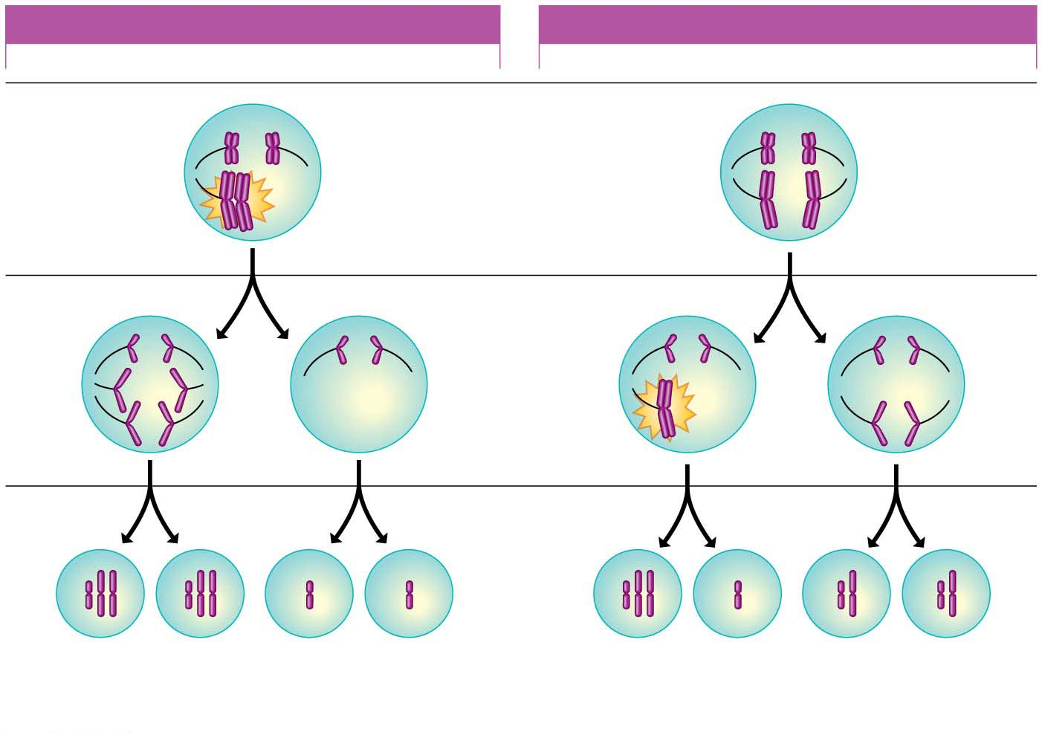
Figure 8.20
NONDISJUNCTION IN MEIOSIS I
NONDISJUNCTION IN MEIOSIS II
Meiosis I
Homologous
chromosomes
fail to separate.
Meiosis II
Sister
chromatids
fail to
separate.
Gametes
n + 1
n + 1
n − 1
n − 1
n + 1
n − 1
n
n
Abnormal
Abnormal
Normal
Notes:
Figure 8.20-s3 Two types of nondisjunction (step 3)

Slide 29
Down Syndrome: An Extra Chromosome 21
In a condition called trisomy세염색체증 21, there are three number 21 chromosomes, making 47 chromosomes in total.
A person with trisomy 21 has a condition called Down syndrome, which
affects about 1 out of every 700 children,
is the most common chromosome number abnormality, and
is the most common serious birth defect in the United States.
Although we don’t know why, the risk of Down syndrome increases with the age of the mother.
The fetuses of pregnant women age 35 and older are therefore candidates for chromosomal prenatal screenings.
Notes:
29
Student Misconceptions and Concerns
1. How meiosis results in four haploid cells yet mitosis yields two diploid cells is often memorized but not understood. It can be explained like this. In mitosis and meiosis, the processes begin with replicated pairs of chromosomes. The two pairs include four items. Sort this group into two subgroups, and you are back to two pairs. Divide again, and you have separated four items into four groups of one. All of the details of these two processes, although eventually addressed, can get in the way of seeing the overall process.
2. Most people have difficulty comprehending large numbers. See Teaching Tips 7–9 below to help relate these large numbers to aspects of students’ lives.
Teaching Tips
1. Consider helping students through mitosis and meiosis by developing an analogy to pairs of shoes. In this case, any given species that is diploid has a certain number of pairs of shoes, or homologous chromosomes.
2. In the shoe analogy, females have 23 pairs of matching shoes, and males have 22 matching pairs and one odd pair—maybe a sandal and a sneaker!
3. You may wish to ask the class why meiosis is necessary. Why not have a male diploid cell fertilize a diploid female cell? In short, the answer is that, if this were true, at every fertilization, we would have genetic doubling.
4. If you wish to continue the shoe analogy, crossing over is somewhat like exchanging the shoelaces in a pair of shoes. A point to make is that the shoes (chromosomes) before crossing over are what you inherited—from either the sperm or the egg; but as a result of crossing over, you no longer pass along exactly what you inherited. Instead, you pass along a combination of homologous chromosomes (or shoes with switched shoelaces). In this shoe analogy, after exchanging shoelaces, we have recombinant shoes!
5. You might consider emphasizing a crucial difference between the processes of mitosis and meiosis. In mitosis, sister chromatids separate at metaphase. In meiosis I metaphase, sister chromatids stay together, and homologous chromosomes separate. After discussing mitosis and meiosis in class, consider asking your students to sketch the alignment of the chromosomes at mitosis metaphase and meiosis I metaphase.
6. The number 2²³ is 8,388,608. This number squared is more than 70 trillion. The authors rounded down to 8 million for 2²³ and squared this to estimate 64 trillion possible combinations. But more precisely, the number of possible zygotes produced by a single pair of reproducing humans, based solely on independent assortment and random fertilization, is over 70 trillion!
7. There are currently about 320 million humans living in the United States. If every person in the United States received about $217,000, it would equal $70 trillion. Here is another way to think of it. If you lived to be 100 years old and spent $22,181.66 every second of your life, (or a million dollars every 45 seconds) you would spend about $70 trillion dollars.
8. The impressive nature of such large numbers is lost on most of us who cannot comprehend such quantities. There are about 64 trillion seconds in 2 million years (actually, 2,028,000 years).
9. Depending on the size of your class, it is likely that at least one of your students has a friend or relative with Down syndrome. A student in your class may even enjoy the chance to talk about their friend or relative.
Active Lecture Tips
1. Sometimes the most basic questions can challenge students and get them focused on the subject at hand. Consider asking your students to work with other students near them to consider why we expect that dogs produce dogs, cats produce only more cats, and chickens only produce chickens. Why does “like produce like”?
2. See the Activity Student Demonstration of Mitosis and Meiosis Using Chromosome Cut-Outs as Models on the Instructor Exchange. Visit the Instructor Exchange in the MasteringBiology instructor resource area for a description of this activity.
3. See the Activity Applying the Concept of Nondisjunction to Trisomy on the Instructor Exchange. Visit the Instructor Exchange in the MasteringBiology instructor resource area for a description of this activity.

Slide 30
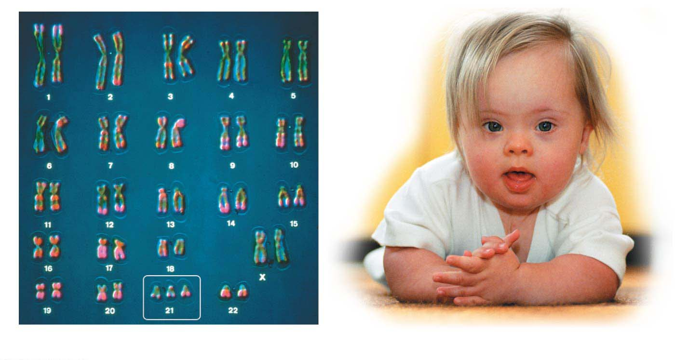
Figure 8.22
LM
Trisomy 21
Karyotyping 핵형분석
Notes:
Figure 8.22 Trisomy 21 and Down syndrome

Slide 31
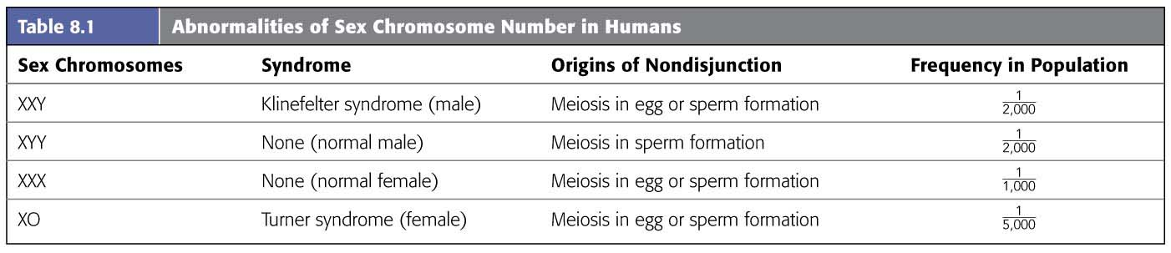
Abnormal Numbers of Sex Chromosomes
Nondisjunction in meiosis can lead to abnormal numbers of sex chromosomes, X and Y.
Unusual numbers of sex chromosomes seem to upset the genetic balance less than unusual numbers of autosomes.
Table 8.1 lists the most common human sex chromosome abnormalities.
Notes:
31
Student Misconceptions and Concerns
1. How meiosis results in four haploid cells yet mitosis yields two diploid cells is often memorized but not understood. It can be explained like this. In mitosis and meiosis, the processes begin with replicated pairs of chromosomes. The two pairs include four items. Sort this group into two subgroups, and you are back to two pairs. Divide again, and you have separated four items into four groups of one. All of the details of these two processes, although eventually addressed, can get in the way of seeing the overall process.
2. Most people have difficulty comprehending large numbers. See Teaching Tips 7–9 below to help relate these large numbers to aspects of students’ lives.
Teaching Tips
1. Consider helping students through mitosis and meiosis by developing an analogy to pairs of shoes. In this case, any given species that is diploid has a certain number of pairs of shoes, or homologous chromosomes.
2. In the shoe analogy, females have 23 pairs of matching shoes, and males have 22 matching pairs and one odd pair—maybe a sandal and a sneaker!
3. You may wish to ask the class why meiosis is necessary. Why not have a male diploid cell fertilize a diploid female cell? In short, the answer is that, if this were true, at every fertilization, we would have genetic doubling.
4. If you wish to continue the shoe analogy, crossing over is somewhat like exchanging the shoelaces in a pair of shoes. A point to make is that the shoes (chromosomes) before crossing over are what you inherited—from either the sperm or the egg; but as a result of crossing over, you no longer pass along exactly what you inherited. Instead, you pass along a combination of homologous chromosomes (or shoes with switched shoelaces). In this shoe analogy, after exchanging shoelaces, we have recombinant shoes!
5. You might consider emphasizing a crucial difference between the processes of mitosis and meiosis. In mitosis, sister chromatids separate at metaphase. In meiosis I metaphase, sister chromatids stay together, and homologous chromosomes separate. After discussing mitosis and meiosis in class, consider asking your students to sketch the alignment of the chromosomes at mitosis metaphase and meiosis I metaphase.
6. The number 2²³ is 8,388,608. This number squared is more than 70 trillion. The authors rounded down to 8 million for 2²³ and squared this to estimate 64 trillion possible combinations. But more precisely, the number of possible zygotes produced by a single pair of reproducing humans, based solely on independent assortment and random fertilization, is over 70 trillion!
7. There are currently about 320 million humans living in the United States. If every person in the United States received about $217,000, it would equal $70 trillion. Here is another way to think of it. If you lived to be 100 years old and spent $22,181.66 every second of your life, (or a million dollars every 45 seconds) you would spend about $70 trillion dollars.
8. The impressive nature of such large numbers is lost on most of us who cannot comprehend such quantities. There are about 64 trillion seconds in 2 million years (actually, 2,028,000 years).
9. Depending on the size of your class, it is likely that at least one of your students has a friend or relative with Down syndrome. A student in your class may even enjoy the chance to talk about their friend or relative.
Active Lecture Tips
1. Sometimes the most basic questions can challenge students and get them focused on the subject at hand. Consider asking your students to work with other students near them to consider why we expect that dogs produce dogs, cats produce only more cats, and chickens only produce chickens. Why does “like produce like”?
2. See the Activity Student Demonstration of Mitosis and Meiosis Using Chromosome Cut-Outs as Models on the Instructor Exchange. Visit the Instructor Exchange in the MasteringBiology instructor resource area for a description of this activity.
3. See the Activity Applying the Concept of Nondisjunction to Trisomy on the Instructor Exchange. Visit the Instructor Exchange in the MasteringBiology instructor resource area for a description of this activity.

Slide 32
Evolution Connection: The Advantages of Sex
Many species can reproduce both sexually and asexually.
Asexual reproduction무성생식
eliminates the need to expend energy forming gametes and copulating with a partner and
confers an evolutionary advantage when organisms are
sparsely distributed or
superbly suited to a stable environment.
Sexual reproduction유성생식 may convey an evolutionary advantage by
producing offspring of varied genetic makeup or
reducing the incidence of harmful genes more rapidly.
Notes:
32
Student Misconceptions and Concerns
1. How meiosis results in four haploid cells yet mitosis yields two diploid cells is often memorized but not understood. It can be explained like this. In mitosis and meiosis, the processes begin with replicated pairs of chromosomes. The two pairs include four items. Sort this group into two subgroups, and you are back to two pairs. Divide again, and you have separated four items into four groups of one. All of the details of these two processes, although eventually addressed, can get in the way of seeing the overall process.
2. Most people have difficulty comprehending large numbers. See Teaching Tips 7–9 below to help relate these large numbers to aspects of students’ lives.
Teaching Tips
1. Consider helping students through mitosis and meiosis by developing an analogy to pairs of shoes. In this case, any given species that is diploid has a certain number of pairs of shoes, or homologous chromosomes.
2. In the shoe analogy, females have 23 pairs of matching shoes, and males have 22 matching pairs and one odd pair—maybe a sandal and a sneaker!
3. You may wish to ask the class why meiosis is necessary. Why not have a male diploid cell fertilize a diploid female cell? In short, the answer is that, if this were true, at every fertilization, we would have genetic doubling.
4. If you wish to continue the shoe analogy, crossing over is somewhat like exchanging the shoelaces in a pair of shoes. A point to make is that the shoes (chromosomes) before crossing over are what you inherited—from either the sperm or the egg; but as a result of crossing over, you no longer pass along exactly what you inherited. Instead, you pass along a combination of homologous chromosomes (or shoes with switched shoelaces). In this shoe analogy, after exchanging shoelaces, we have recombinant shoes!
5. You might consider emphasizing a crucial difference between the processes of mitosis and meiosis. In mitosis, sister chromatids separate at metaphase. In meiosis I metaphase, sister chromatids stay together, and homologous chromosomes separate. After discussing mitosis and meiosis in class, consider asking your students to sketch the alignment of the chromosomes at mitosis metaphase and meiosis I metaphase.
6. The number 2²³ is 8,388,608. This number squared is more than 70 trillion. The authors rounded down to 8 million for 2²³ and squared this to estimate 64 trillion possible combinations. But more precisely, the number of possible zygotes produced by a single pair of reproducing humans, based solely on independent assortment and random fertilization, is over 70 trillion!
7. There are currently about 320 million humans living in the United States. If every person in the United States received about $217,000, it would equal $70 trillion. Here is another way to think of it. If you lived to be 100 years old and spent $22,181.66 every second of your life, (or a million dollars every 45 seconds) you would spend about $70 trillion dollars.
8. The impressive nature of such large numbers is lost on most of us who cannot comprehend such quantities. There are about 64 trillion seconds in 2 million years (actually, 2,028,000 years).
9. Depending on the size of your class, it is likely that at least one of your students has a friend or relative with Down syndrome. A student in your class may even enjoy the chance to talk about their friend or relative.
Active Lecture Tips
1. Sometimes the most basic questions can challenge students and get them focused on the subject at hand. Consider asking your students to work with other students near them to consider why we expect that dogs produce dogs, cats produce only more cats, and chickens only produce chickens. Why does “like produce like”?
2. See the Activity Student Demonstration of Mitosis and Meiosis Using Chromosome Cut-Outs as Models on the Instructor Exchange. Visit the Instructor Exchange in the MasteringBiology instructor resource area for a description of this activity.
3. See the Activity Applying the Concept of Nondisjunction to Trisomy on the Instructor Exchange. Visit the Instructor Exchange in the MasteringBiology instructor resource area for a description of this activity.

